Slide 1
Housekeeping
Today:
More databases!!!!!!!!!!!!!!!!!!!!!!!!!!!!!!!!! We’ll use the 008 files (3 csv + this PP) for this, they’re on Moodle.
Review loading data into Access, with some small twists.
Review queries that we looked at last time.
Look at basic SQL for queries.
Do some slightly more complex queries (grouping, filtering)
Some challenges for you all to try and work through. (This is really something that requires some trial and error to work through. The mechanics of how Access works are important for this class and useful overall, but understanding the basics of how to work with data is really useful if you’re going to have any cubical based existence in the future. This is not a teacher propaganda comment.)
We’ll look at some theory, show some examples, give some work time, then I’ll go over solutions.

Slide 2
Database Details #2
With Database Challenges

Slide 3
Relationships in Access
In Access, every time we are joining two datasets we need to select what to “Join On”.
We need some value that is shared to connect the two sides together.
We draw the line between the two to make the connection.
We can also use the Relationships page to preset these connections.
E.g. if we have “classes”(OA01) and “courses”(CMIS1101) in a database, there is likely a universal connection between the two. Likely a “CourseID” in the class table.
We can predefine this connection, then when using it in queries, it’ll automatically connect itself correctly.

Slide 4
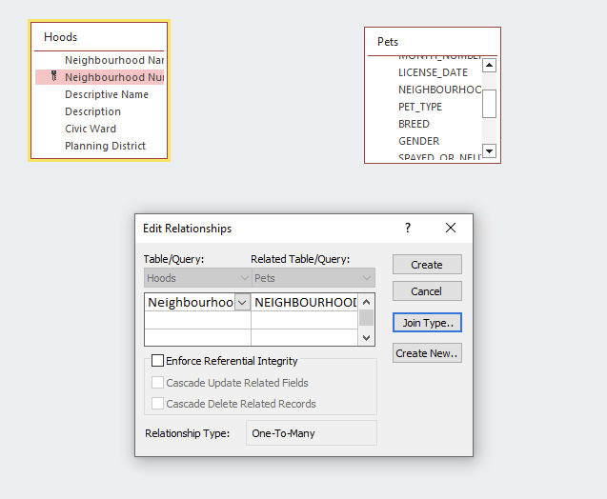
Relationships
The relationship is basically like a join, as that’s what it is.
The two tables in the relationship will “know” how to connect themselves together.
If we had something where we allowed people to use this to look for answers, doing this allows them to use everything without needing to join.
They can use it like a pivot table once connected.

Slide 5
SQL
We’ll also peek at the SQL of some of our queries.
We’ll do a bit more detail next time, unless this is easy for you, then we can today.
This is what the design view generates, and what actually communicates with the data.
We can write these ourselves, and would in a “real” scenario.
For us, relying on the tool is mostly OK.
Access isn’t perfect, so there are times where you might need to manually edit what the tool made (in real life, not so much here).
SQL is probably the single largest skill in this class that has “commercial appeal”.
For many/most white collar jobs, SQL is a beneficial resume point.

Slide 6
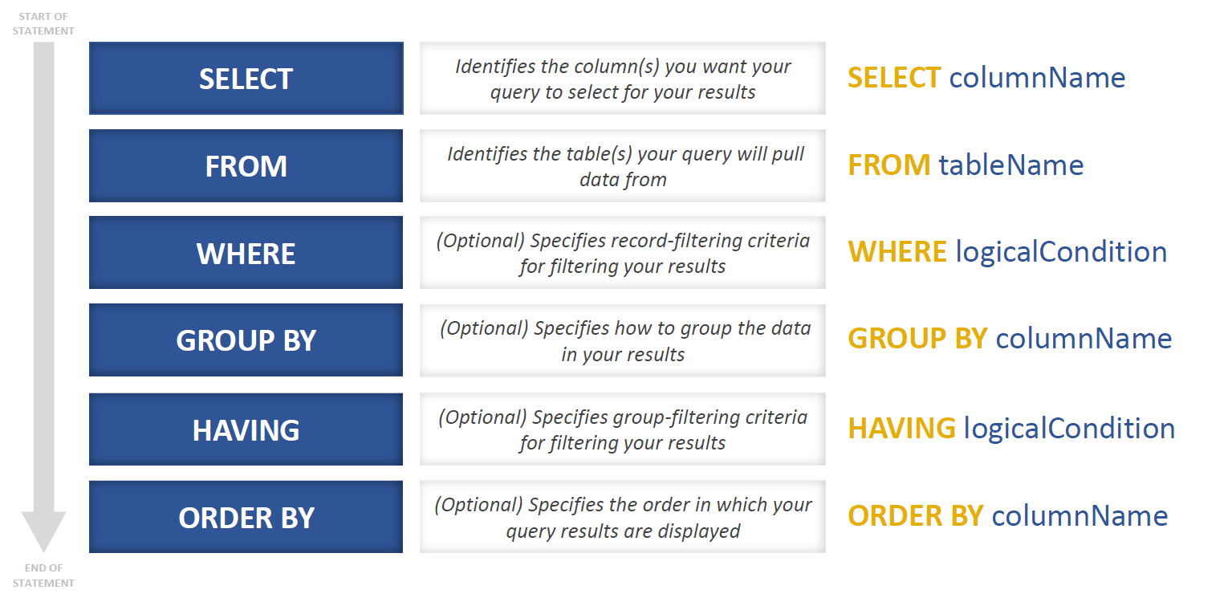

Slide 7
SQl Details
We don’t need to know how to write complex queries.
We should be able to handle simple ones.
When we make ones with the tool, think about what is being created, then check the actual SQL.
You can see if your thoughts match what Access did.
The SELECT, FROM, WHERE is usually pretty simple to think of.
The one complication is joins in the From clause, that comes with time.
If we have complex or multipart ones, we can always break it into steps.

Slide 8
DB Challenges
Try to do these things in Access with the data we’ll load.
Each one is much easier if we think about it in parts.
Which fields do I need to display to get what I need?
If/how do I need to connect tables together?
Do I need to do any grouping and aggregation (totals per group).
Do I need to filter data out?
Do I need some calculation?
I think that all the concepts that you need for this we’ve touched on. If there’s one thing I missed or you forgot, just let me know. (Or search help/google, if you’re confident).
Note: The Access help pages online from MS are good for this stuff, with examples.

Slide 9
Warm-up
List hoods and building type where there are 0 unoccupied of that type in that hood.
Select the fields we need, connect data, filter what we want to see.
Which Hood has the most Apartment (1-4 stories) that are occupied.
Connect hoods and units.
Determine which values are needed to show this.
Decide on if things need to be filtered.
Which Ward has the largest number of unused (unoccupied or no longer in use) apartments (1-4 or 5+)?
We can add values in the Field field by doing Excel-ish calculations the the columns in square brackets.
[UNOCCUPIED]+[NO_LONGER_IN_USE]
When using grouping, we can use the WHERE thing in the grouping to set a filter.

Slide 10
Number of hoods with no unoccupied properties.
Number of dogs and cats per hood.
Connect the hoods and the pets data.
Select the data you need to see for this question.
Determine if you need to group the data.
Determine if you need to filter something out. Determine what, if anything, needs to be calculated.
List of ALL hoods with the number of Spayed or Neutered total pets and the number of occupied buildings.
Can do in two steps, or with a 3 way join. (Note the ALL…)

Slide 11
Number of non dog or cat pets per hood.
Not “X” is a criteria for not equals filters. More than one can exist…
Which dog is most popular?
All dog breeds with greater than 100 registrations.
This is similar to the above one.
How many dog breeds are in each hood?
Try to phrase and answer a question… If it doesn’t work, we can try to solve it…

